Slide 1
Training : Day 3
By the end of this module You will be able to :-
  General Idea of Apex Language
  Create Apex Classes
  Functions, list, Set, data type
  Constructor
  Apex query, return type of query.
  For loop on Apex query
  Map and returning apex in MAP
  Concept of System.Log and System.debug() for testing their work for now.

Slide 2
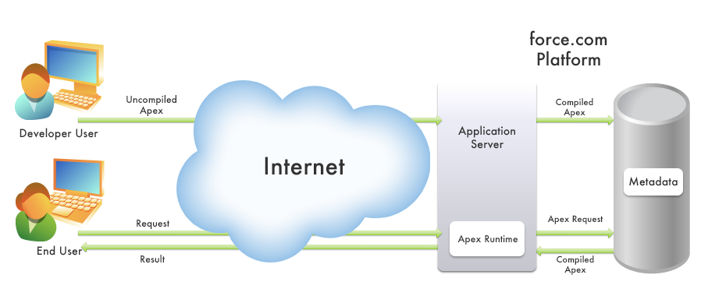
What is Apex & How it works
Force.com Apex code is a strongly-typed, object-oriented programming language that allows developers to execute flow and transaction control statements on the Force.com platform server in conjunction with calls to the Force.com API. Using syntax that looks like Java and acts like database stored procedures, Apex code enables developers to add business logic to most system events, including button clicks, related record updates, and Visualforce pages. Apex scripts can be initiated by Web service requests and from triggers on objects

Slide 3
Where you run your Apex
There are three types of organizations where you can run your Apex:
• A developer organization: an organization created with a Developer Edition account.
• A production organization: an organization that has live users accessing your data.
• A sandbox organization: an organization created on your production organization that is a copy of your production organization.
You cannot develop Apex in your Salesforce.com production organization. Live users accessing the system while you are developing can destabilize your data or corrupt your application. Instead, salesforce.com recommends that you do all your development work in either a sandbox or a Developer Edition organization.

Slide 4
On which editing environment you write Apex
You can write Apex scripts and tests in any of the following editing environments:
• The Force.com IDE is a plug-in for the Eclipse IDE.
• The Salesforce.com user interface.
• Any text editor, such as Notepad. You can write your Apex script, then either copy and paste it into your application, or use one of the API calls to deploy it.

Slide 5
Writing Tests
Testing is the key to successful long term development, and is a critical component of the development process. salesforce.com strongly recommends that you use a test-driven development process, that is, test development that occurs at the same time as code development.
To facilitate the development of robust, error-free code, Apex supports the creation and execution of unit tests. Unit tests are class methods that verify whether a particular piece of code is working properly. Unit test methods take no arguments, commit no data to the database, send no emails, and are flagged with the testMethod keyword in the method definition.
In addition, before you deploy Apex or package it for the Force.com AppExchange, the following must be true:
• 75% of your Apex code must be covered by unit tests, and all of those tests complete successfully.
Note the following:
- When deploying to a production organization, every unit test in your organization namespace is executed.
- Calls to System.debug are not counted as part of Apex code coverage in unit tests.
- While only 75% of your Apex code must be covered by tests, your focus shouldn't be on the percentage of code that is covered. Instead, you should make sure that every use case of your application is covered, including positive and negative cases, as well as bulk and single record. This should lead to 75% or more of your code being covered by unit tests.
• Every trigger has some test coverage.
• All classes and triggers compile successfully.
How to write Test cases in details we see it later.

Slide 6
Apex
When Should I Use Apex?
The Salesforce.com prebuilt applications provide powerful CRM functionality. In addition, Salesforce.com provides the ability
to customize the prebuilt applications to fit your organization. However, your organization may have complex business processes that are unsupported by the existing functionality.When this is the case, the Force.com platform includes a number of ways for advanced administrators and developers to implement custom functionality. It includes.
• Create Web services
• Create email services
• Perform complex validation over multiple objects
• Create complex business processes that are not supported by workflow
• Create custom transactional logic (logic that occurs over the entire transaction, not just with a single record or object)
• Attach custom logic to another operation, such as saving a record, so that it occurs whenever the operation is executed,
regardless of whether it originates in the user interface, a Visualforce page, or from the Web Services API

Slide 7
Apex
Syntax:
  [virtual | abstract | with sharing | without sharing | (none)]
  class ClassName [implements InterfaceNameList | (none)] [extends Class Or InterfaceName |
  (none)]
  {
  // The body of the class
  }
Note:
  The extends keyword is not enabled for all organizations. If you need it for your application, contact your salesforce.com representative.
  The abstract and virtual keywords are not enabled for all organizations.
  A class can implement multiple interfaces, but only extend one existing class. This restriction means that Apex does not support multiple inheritance.

Slide 8
Declaring Class Variables & Defining Class Methods
Declaring Class Variables:-
To declare a variable, specify the following:
  Optional: Modifiers, such as public or final.
  Required: The data type of the variable, such as String or Boolean.
  Required: The name of the variable.
  Optional: Initialization of the variable.
private static final Integer MY_INT;
private final Integer i = 1; // Initialization
Defining Class Methods:-
To define a method, , specify the following:
  Optional: Modifiers, such as public or protected.
  Required: The data type of the value returned by the method, such as String or Integer. Use void if the method does not return a value.
  Required: A list of input parameters for the method, separated by commas, each preceded by its data type, and enclosed in parentheses (). If there are no parameters, use a set of empty parentheses. A method can only have 32 input parameters.
  Required: The body of the method, enclosed in braces {}. All the code for the method, including any local variable declarations, is contain
      public static Integer getInt() {
      return MY_INT;
      }

Slide 9
Constructors
Using Constructors
A constructor is code that is invoked when an object is created from the class blueprint. You do not need to write a constructor for every class. If a class does not have a user-defined constructor, an implicit, no-argument, public one is used.
The syntax for a constructor is similar to a method, but it differs from a method definition in that it never has an explicit return
type and it is not inherited by the object created from it.
After you write the constructor for a class, you must use the new keyword in order to instantiate an object from that class, using that constructor. For example, using the following class:
      public class TestObject {
        // The no argument constructor
        public TestObject() {
        // more code here
        }
      }
A new object of this type can be instantiated with the following code:
    TestObject myTest = new TestObject();
Apex allows you to use the private, protected, public, and global access modifiers when defining methods and variables.

Slide 10
Apex Properties
An Apex property is similar to a variable, however, you can do additional things in your script to a property value before it is accessed or returned. Properties can be used in many different ways: they can validate data before a change is made; they can prompt an action when data is changed, such as altering the value of other member variables; or they can expose data that is retrieved from some other source, such as another class.
Property definitions include one or two code blocks, representing a get accessor and a set accessor:
• The code in a get accessor executes when the property is read.
• The code in a set accessor executes when the property is assigned a new value.
    public class BasicClass {
        // Property declaration
    access_modifier return_type property_name {
    get {
//Get accessor code block
}
set {
//Set accessor code block
}
}
For Example:-
      public class AutomaticProperty {
      public integer MyReadOnlyProp { get; }
      public double MyReadWriteProp { get; set; }
      public string MyWriteOnlyProp { set; }
      }

Slide 11
For Loops
Apex supports three variations of the for loop:
• The traditional for loop:
    for (init_stmt; exit_condition; increment_stmt) {
    code_block
    }
  • The list or set iteration for loop:
    for (variable : list_or_set) {
      code_block
    }
• The SOQL for loop:
for (variable : [soql_query]) {
    code_block
    }
    OR
for (variable_list : [soql_query]) {
code_block
}

Slide 12
Examples of Each Loop
Traditional For Loops
  for (Integer i = 0, j = 0; i < 10; i++) {
  System.debug(i+1);
  }
List or Set Iteration For Loop
  Integer[] myInts = new Integer[]{1, 2, 3, 4, 5, 6, 7, 8, 9, 10};
  for (Integer i : myInts) {
  System.debug(i);
  }
SOQL For Loops
  String s = 'Acme';
  for (Account a : [select id, name from account where name like :(s+'%')]) {
    // Your code
  }

Slide 13
Valid SOQL Statements
List<Account> aa = [select id, name from account where name = 'Acme'];
Contact c = new Contact(account = [select name from account limit 1]);
Integer i = [select count() from contact where lastname = 'Weissman'];
Integer j = 5 * [select count() from account]

Slide 14
SOSL Statements
SOSL statements evaluate to a list of lists of sObjects, where each list contains the search results for a particular sObject type.
The result lists are always returned in the same order as they were specified in the SOSL query.
SOSL queries are only supported in Apex classes and anonymous blocks.
You cannot use a SOSL query in a trigger.
If a SOSL query does not return any records for a specified sObject type, the search results include an empty list for that sObject.
  For example, you can return a list of accounts, contacts, opportunities, and leads that begin with the phrase map:
    List<List<SObject>> searchList = [FIND 'map*' IN ALL FIELDS RETURNING Account (id, name),Contact, Opportunity, Lead];
    From searchList, you can create arrays for each object returned:
      Account [] accounts = ((List<Account>)searchList[0]);
      Contact [] contacts = ((List<Contact>)searchList[1]);
      Opportunity [] opportunities = ((List<Opportunity>)searchList[2]);
      Lead [] leads = ((List<Lead>)searchList[3]);

Slide 15
Using Apex Variables in SOQL and SOSL Queries
SOQL and SOSL statements in Apex can reference Apex script variables and expressions if they are preceded by a colon (:).
This use of a local script variable within a SOQL or SOSL statement is called a bind. The Apex parser first evaluates the local variable in script context before executing the SOQL or SOSL statement. Bind expressions can be used as:
    • The search string in FIND clauses
    • The filter literals in WHERE clauses
    • The numeric value in LIMIT clauses
    • The value of the IN or NOT IN operator in WHERE clauses, allowing filtering on a dynamic set of values. Note that this is of particular use with a list of IDs or Strings, though it works with lists of any type.
    • The division names in WITH DIVISION clauses
  For example:
    Account A = new Account(name='xxx');
    insert A;
    Account B;
    // A simple bind
    B = [select id from account where id = :A.id];
    // A bind with arithmetic
    B = [select id from account where name = :('x' + 'xx')];
    String s = 'XXX';
    // A bind with expressions
    B = [select id from account where name = :'XXXX'.substring(0,3)];

Slide 16
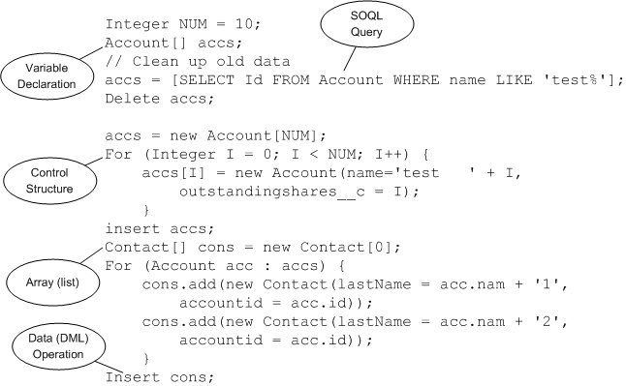
Piece of Code in Action

Slide 17
Using Collections
Apex has the following types of collections:
• Lists (arrays)
• Maps
• Sets
A list is a collection of elements, such as Integers, Strings, objects, or other collections. Use a list when the sequence of elements is important. You can have duplicate elements in a list.
A set is a collection of unique, unordered elements. It can contain primitive data types, such as String, Integer, Date, and so on. It can also contain more complex data types, such as sObjects.
A map is a collection of key-value pairs. Keys can be any primitive data type. Values can include primitive data types, as well as objects and other collections. Use a map when finding something by key matters. You can have duplicate values in a map, but each key must be unique.
=============================================================================
Map<Id,Account> mapAct = new Map<ID,Account>([select id,Name from Account]);
List<Account> lstAct = new List<Account>(select id,Name from Account);
lstAst = [select id,Name from Account];

Slide 18
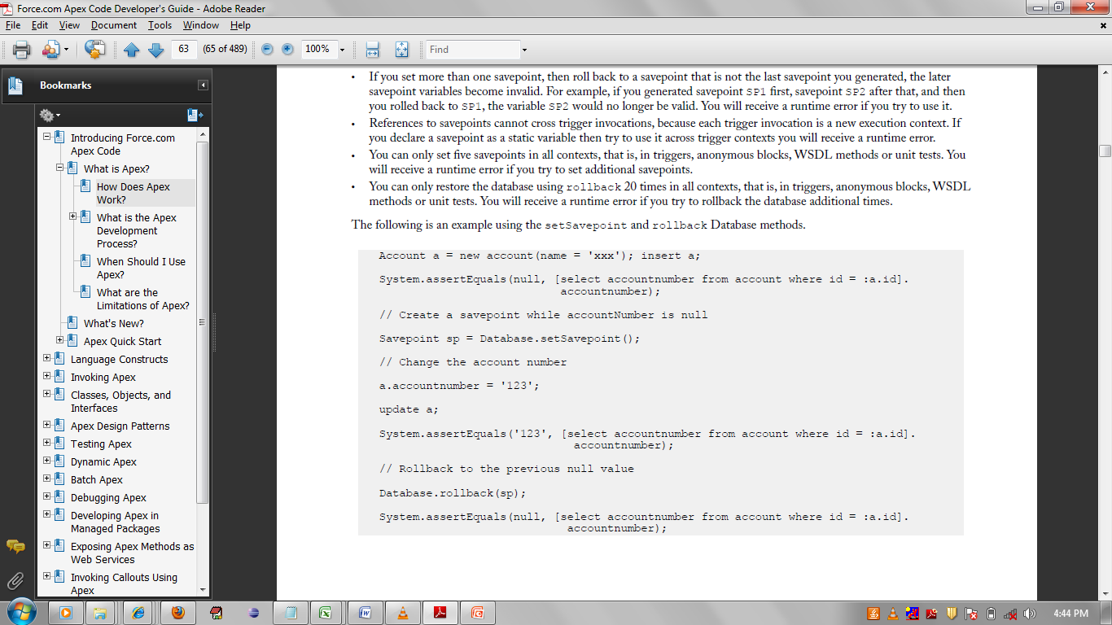
Transaction Control
All transactions are controlled by the trigger, Web Service, Visual force page or anonymous block that executes the Apex script. If the Apex script completes successfully, all changes are committed to the database. If the Apex script does not complete successfully, all database changes are rolled back.
However, sometimes during the processing of records, your business rules require that partial work (already executed DML statements) be “rolled back” so that the processing can continue in another direction.
There is lot of limitations for Using savepoint, for details refer salesforce documentation.

Slide 19
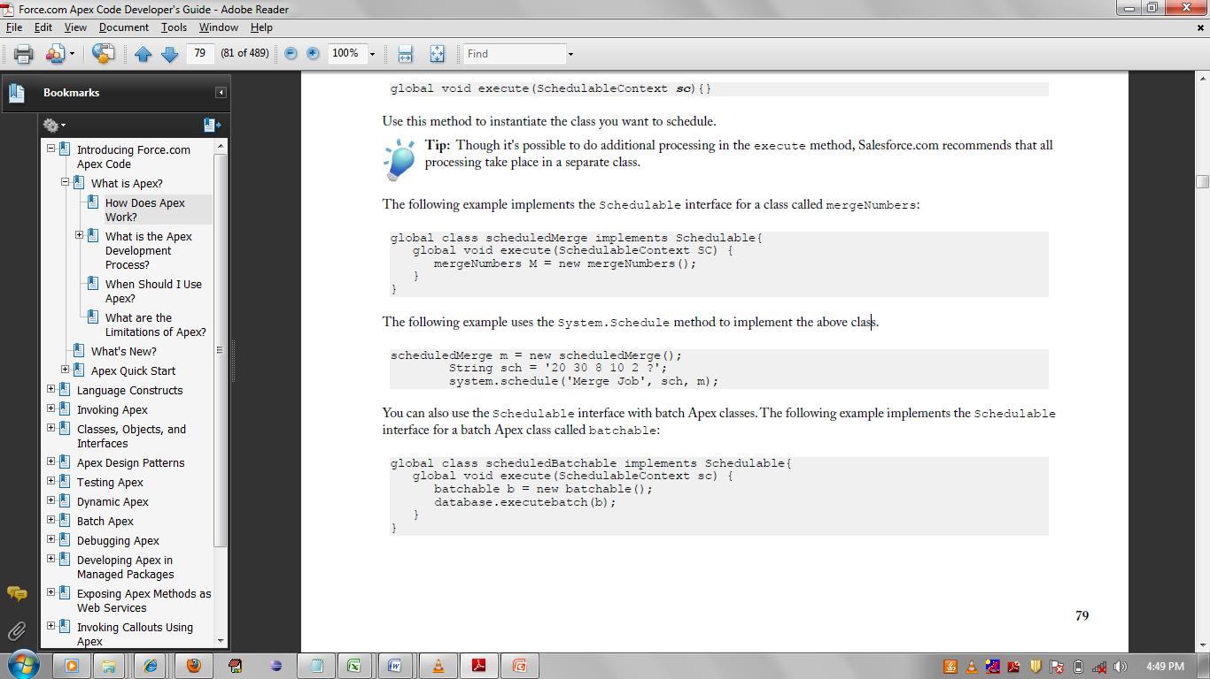
Apex Scheduler
To invoke Apex classes to run at specific times, first implement the Schedulable interface for the class, then specify the schedule using either the Schedule Apex page in the Salesforce.com user interface, or the System.schedule method.
Note:- Time in following sequence:- Seconds,Minutes,Hours,Day_of_Month,Month,Day_Of_
Week,optional_Year.
:: For special characters and details refer Salesforce Documentation.

Slide 20
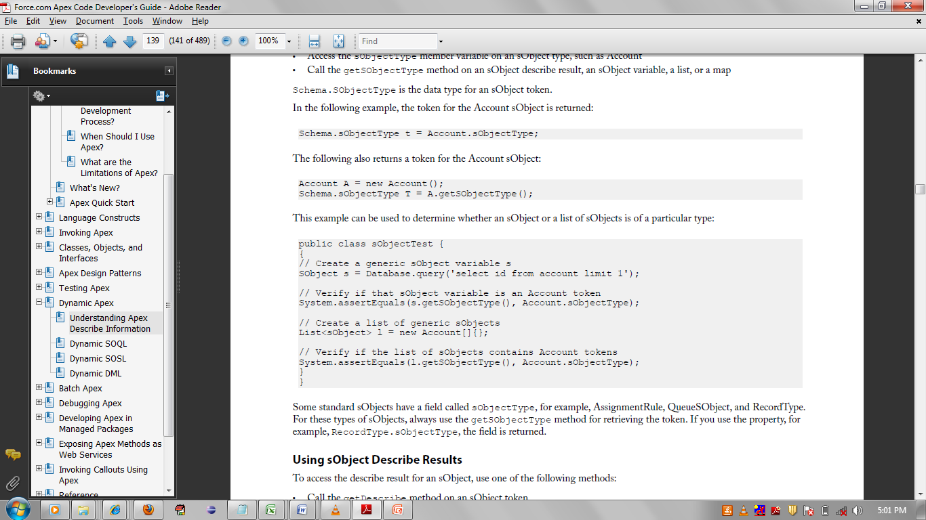
Understanding Apex Describe Information
Apex provides two data structures for sObject and field describe information:
• Token—a lightweight, serializable reference to an sObject or a field that is validated at compile time.
• Describe result—an object that contains all the describe properties for the sObject or field. Describe result objects are not serializable, and are validated at runtime.
Using sObject Tokens

Slide 21
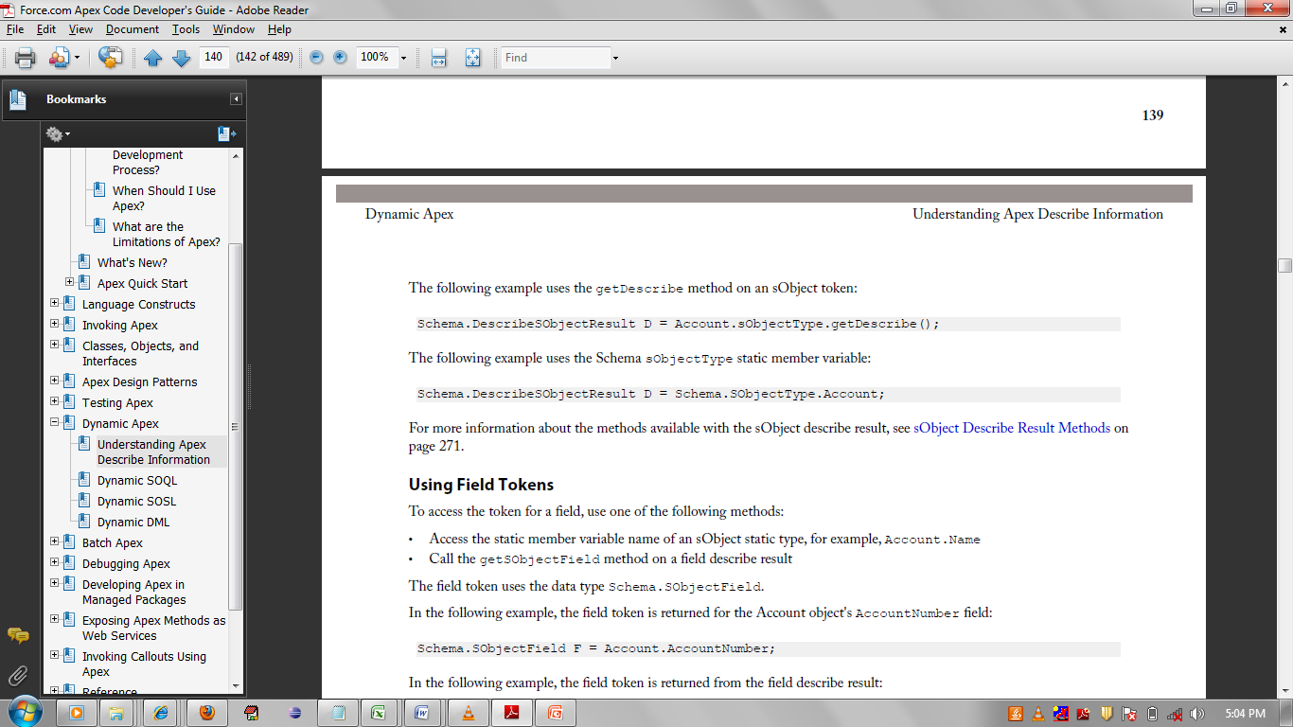
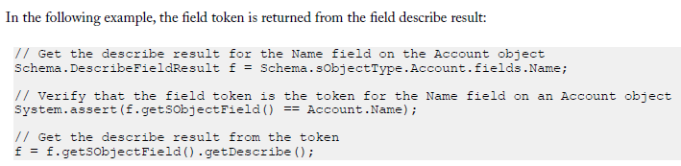
… Apex Describe Information

Slide 22
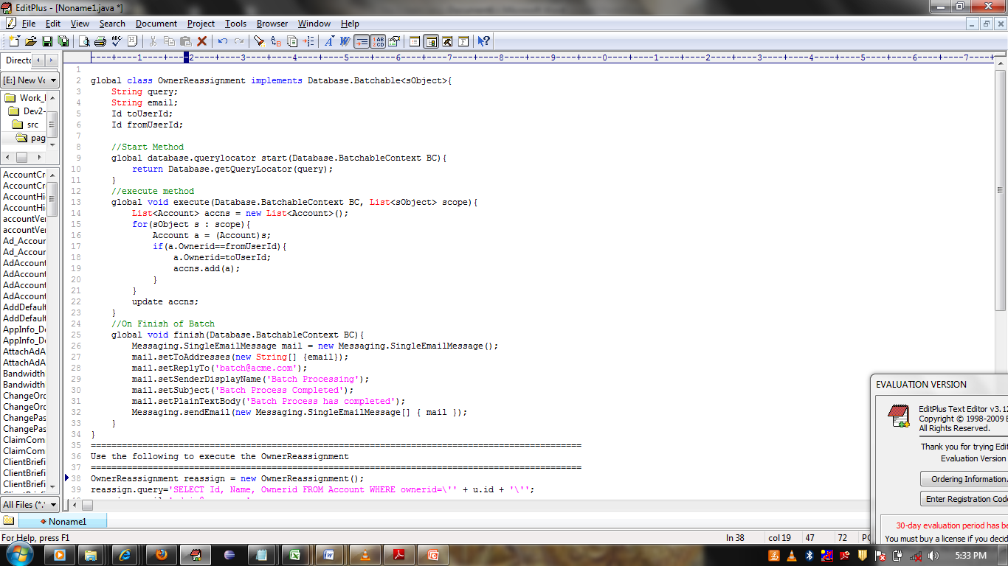
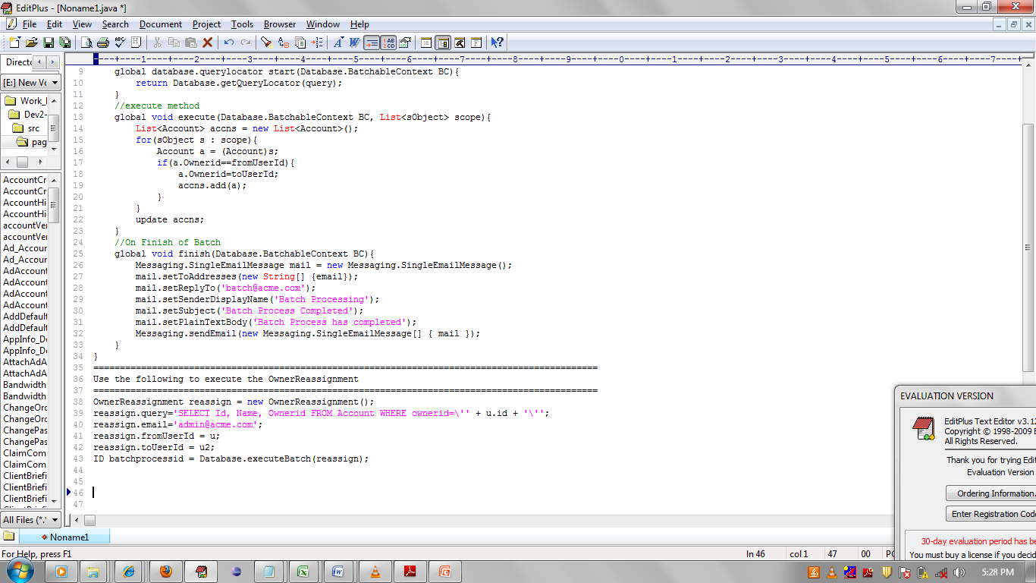
Batch Apex
A developer can now employ batch Apex to build complex, long-running processes on the Force.com platform. For example, a developer could build an archiving solution that goes through all Accounts and Opportunities on a nightly basis and reassigns them if necessary, based on custom criteria.olution that runs on a nightly basis, looking for records past a certain date and adding them to an archive. Or a developer could build a data cleansing operation

Slide 23
Understanding Debug logs
A debug log records database operations, system processes, and errors that occur when executing a transaction or while running unit tests. The system generates a debug log for a user every time that user executes a transaction that is included in the filter criteria.
Using the System Log Console
Access the System Log console from the Salesforce.com user interface by clicking
Your Name➤ System Log in the upper right corner of any page
Debugging Apex API Calls
All API calls that invoke Apex support a debug facility that allows access to detailed information about the execution of the script, including any calls to System.debug().
System.debug(logginglevel.INFO, 'MsgTxt');

Slide 24
Exercise
1) Create a class and a static function which take classid as argument and returns all names of the students in that class as a list.
2) Create a function which returns a map where key is class and value is set of studentid in it.
3) Create a function which take 2 dates as argument and return number of working days between two days excluding both days(Saturday and Sunday is nonworking)
4) Create a stack class in apex.
5) Create a Scheduler to mail to Opportunity Owner , if not modified for last 30 days.
6) Create a Class which show the list of sobjects exists in Organization.
7) Create a class and a static function which take ContactID as argument. Create one Custom field in Account Object(ContactIDs), it is comma separated of all related Contact IDs, check if it is Null or not:-
IF Null, then fetch all related Account Contacts and store IDs of all Contacts in it.
IF Not Null, then check Is Contact Id exist on this field, if not then append it on that field.
8) Create 2 new Fields of type Lookup in Opportunity named ( BillToContact(Contact) and Manager(Account). Create a function in Class which called on Update of Opportunities (from Trigger), it take List<Oppty> as argument and in function check BillToContact Field if it is not Blank and Manager is Blank then populate Manager Field by related account.

